Slide 1

Become the nhibernate Guru

Slide 2


Torkel Ödegaard
www.codinginstinct.com

Slide 3
Nhibernate?
ORM (Object-Relational Mapper)
Transparent persistance
Persistence ignorance

Slide 4
The problem?
Identity map (L1 Cache)
Unit Of Work (Session Flush)
Cascading
Attached & Detached
Lazy loading & Proxy Objects
ID generation & unsaved-value
Concurrency

Slide 6
Order
Customer
*
*
OrderLine
Corporate
Customer
Personal
Customer

Slide 7
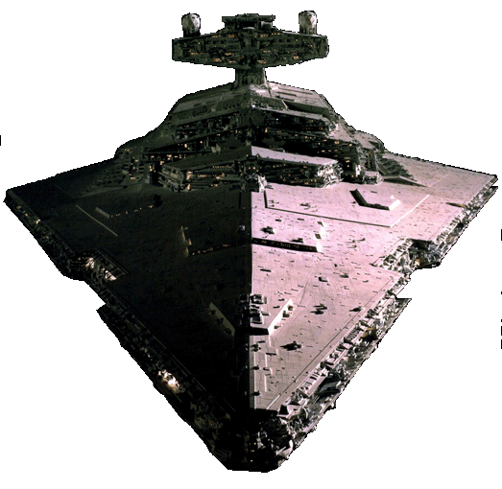
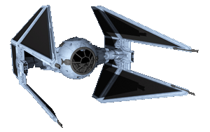
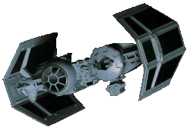
IStarShip
Notes:
Så jag döpte om seminariet till:

Slide 8

Those WERE the droids I was looking for...

Slide 9
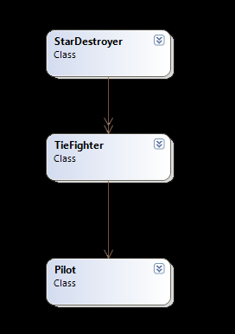
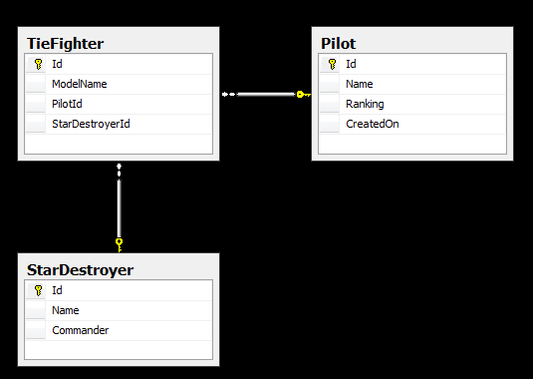

Slide 10
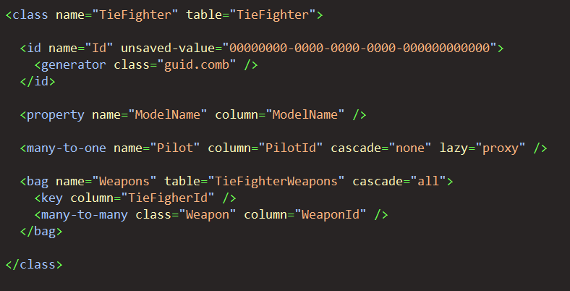
MAPPing

Slide 11
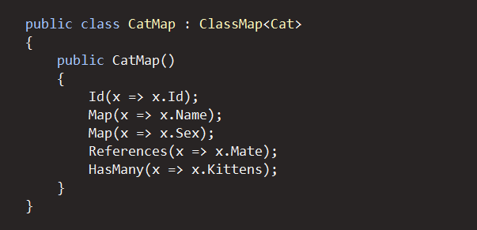
Mapping

Slide 12
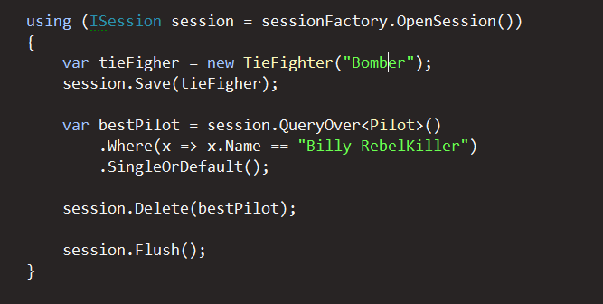
example

Slide 13
unit of work
Insert entity #1
Insert entity #2
Update entity #3
Delete collection entity #5
Update collection entity #6
Delete entity #8
session.Flush()

Slide 14
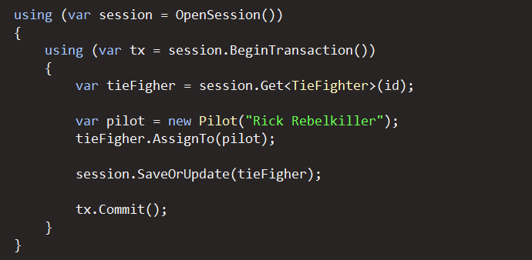
Transaction
Unit Of Work

Slide 15
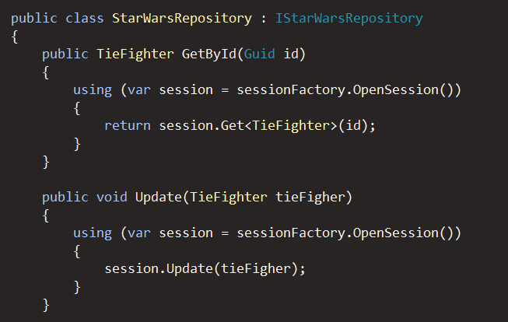
Session management

Slide 16
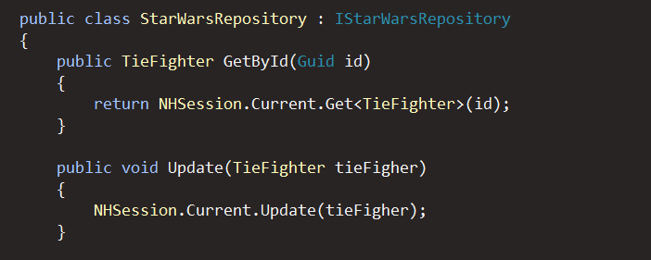
Session management

Slide 17
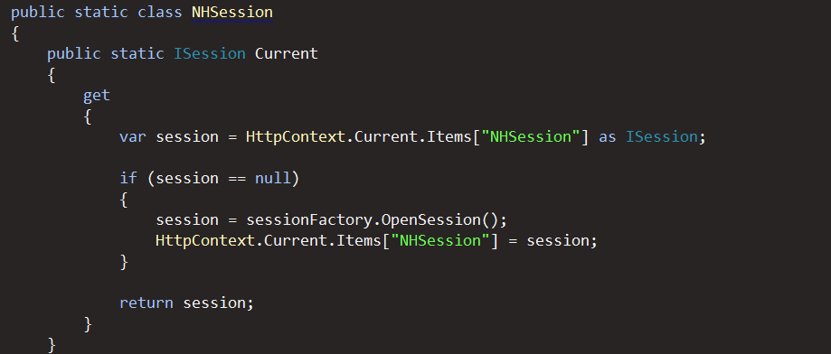
Session management

Slide 18
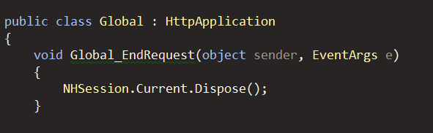
Session management

Slide 19
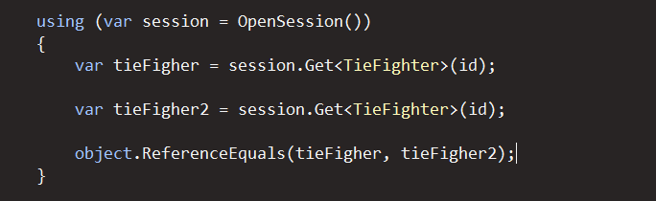
identity map
True

Slide 20
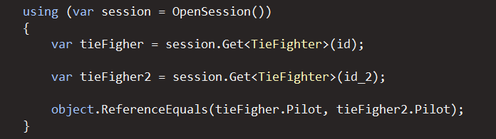
identity map
Id | ModelName | PilotId
1 | Bomber | 2
2 | Interceptor | 2
True

Slide 21
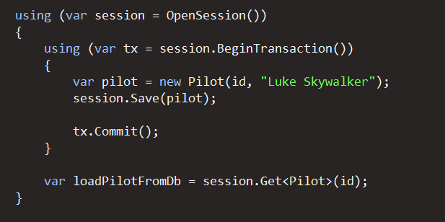
identity map - Problems
Same instance
Will return instance from identity map

Slide 22
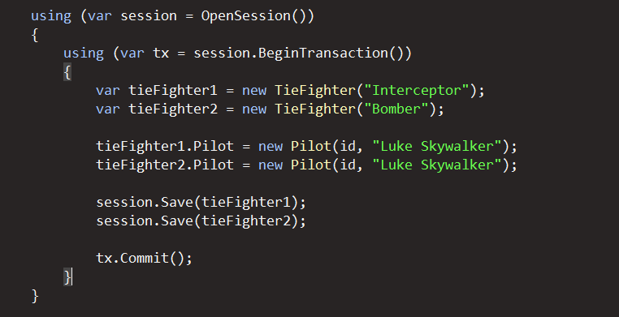
identity map - Problems
NHibernate.NonUniqueObjectException
A different object with the same identifier value was already associated with the session
Two instances with same id

Slide 23
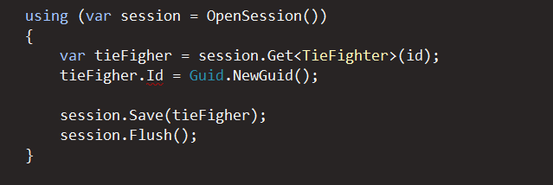
identity map - Problems
NHibernate.HibernateException
Identifier of an instance of TieFighter was altered …

Slide 24
Cascading

Slide 25
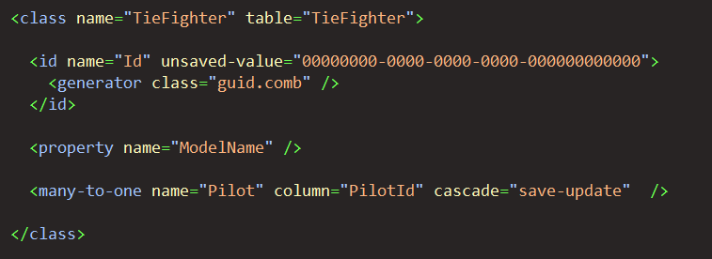
Cascading

Slide 26
cascading
None
Save-update
Delete
Delete-orphan
All
All-delete-orphan

Slide 27
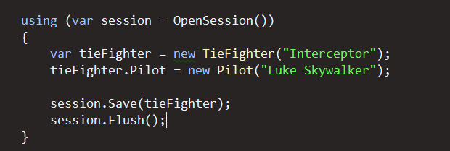
Cascade & Save-update
Transient (unsaved) instance
Transient (unsaved) instance
INSERT INTO Pilot ....
INSERT INTO TieFighter ...

Slide 28
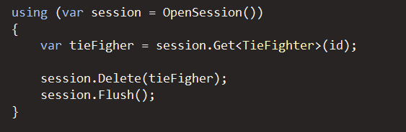
Cascade & delete
DELETE TieFighter ...
DELETE Pilot ...

Slide 29
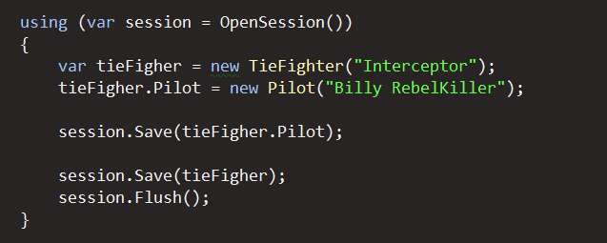
Cascade & None
Transient (unsaved) instance
Transient (unsaved) instance
NHibernate.TransientObjectException
Object references an unsaved transient instance -save the transient instance before flushing

Slide 30
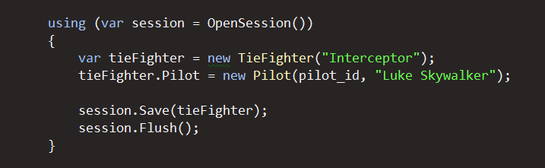
Cascade & none
INSERT TieFighter ...

Slide 31
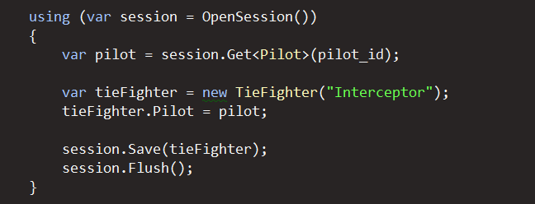
Cascade & none

Slide 32
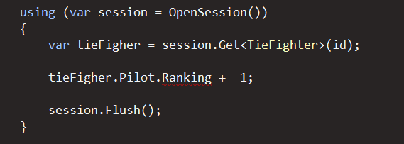
Cascade & none
UPDATE Pilot ...
Notes:
Imutable true

Slide 33
Why???? I did set cascade = none

Slide 34
Cascade & none
UPDATE Pilot ...
Notes:
Imutable true

Slide 35
Attached / Detached

Slide 36
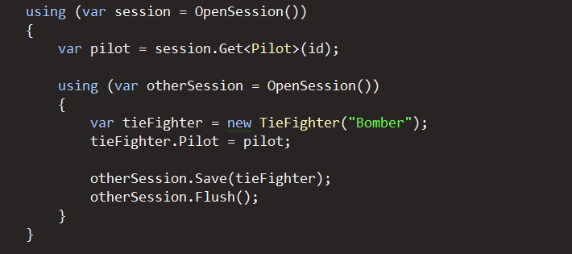
Attached
NHibernate.HibernateException
Illegal attempt to associate a collection with two
open sessions

Slide 37
Detached
*

Slide 38
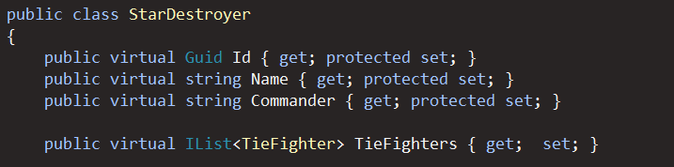
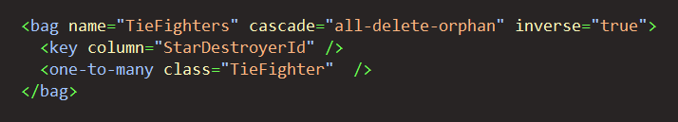
Attached / Detached

Slide 39
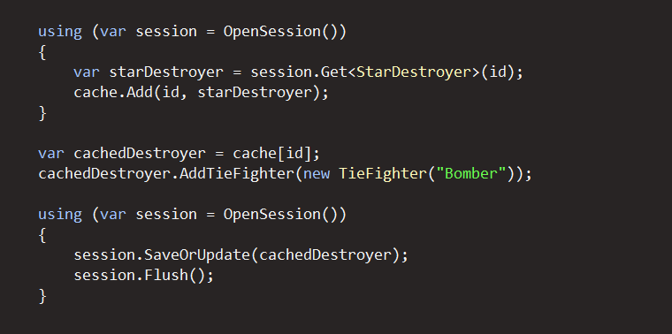
Detached
INSERT INTO TieFighter ...
UPDATE StarDestroyer ...
UPDATE TieFighter #1 ...
UPDATE TieFighter #2 ...
UPDATE TieFighter #3 ...
UPDATE TieFighter #4 ...
UPDATE TieFighter #5 ...
Updating a detached instance

Slide 40
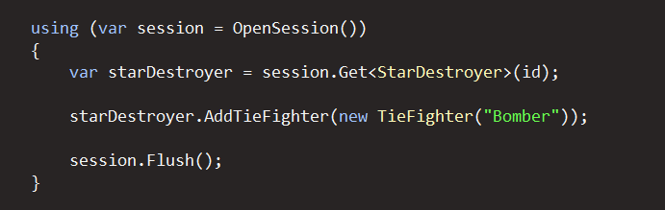
The ideal

Slide 41
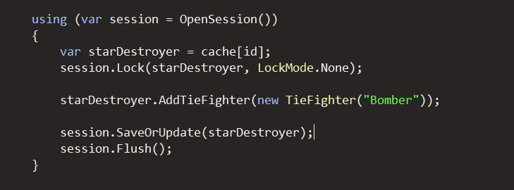
Reassociate
Reassociate (attaches) instance to session
INSERT INTO TieFighter ...

Slide 42
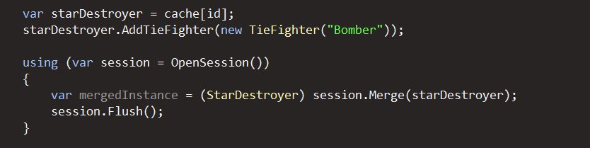
Merge
Modified detached Instance
Attached instance with modifications
SELECT ... FROM StarDestroyer WHERE ...
SELECT ... FROM TieFigher WHERE ...
INSERT INTO TieFighter ...

Slide 43
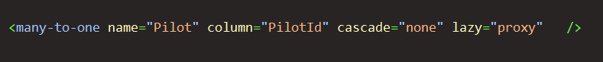
Lazy Loading

Slide 44
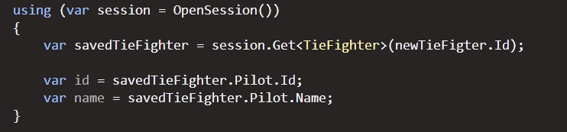
PRoxy

Slide 45
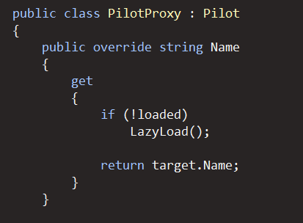
Proxy

Slide 46
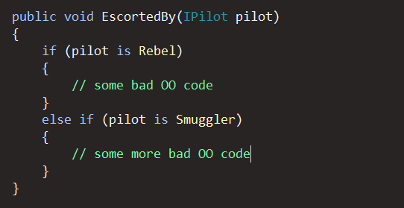
PRoxy

Slide 47
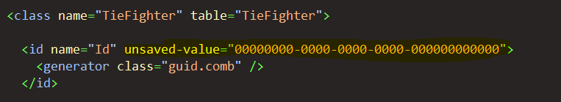
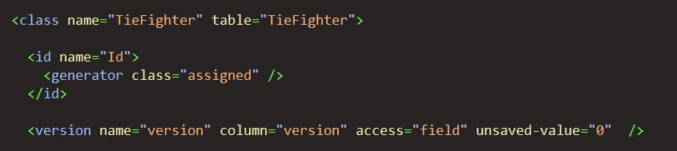
unsaved-value

Slide 48
Concurrency
UPDATE Pilot
SET Version = 2
Name = ’Boba Fett’
Ranking = 1
WHERE Id = ’62E96390-DDB4-493A-A216-62B45C86312’
AND Version = 1
NHibernate.StaleObjectException

Slide 50
resources
http://nhforge.org/
http://ayende.com/blog
http://www.codinginstinct.com
http://sharparchitecture.net/
http://nhprof.com
Torkel.odegaard@gmail.com

